Slide 1

Arrays

Slide 2

Exam Objectives
Working with Java Arrays
Declare, instantiate, initialize and use a one-dimensional array.
Declare, instantiate, initialize and use a two-dimensional array.

Slide 3
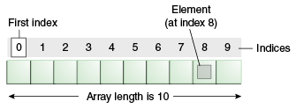
Arrays: An Introduction
An array is a container of values.
In general we operate on a single variable/value/object.
When there arises a need for holding multiple values/object ,then we take help of Arrays.
An array of integer type can hold multiple values of integer types.
We have already seen that in the argument to main method an array of String type values are passed.

Slide 4
Structure of An Array
An array is an object contains values of the type specified in array declaration statement.
An array is allocated contiguous blocks memory.
Each block of memory in an array can be accessed by a unique index that is assigned to that block.
Indexing in array starts from 0.
An element in the 3 block of array names ‘arr’, can be accessed programmatically as arr[2].
Once created size of the array cannot be changed.
Loops are used to iterate over the entire array.

Slide 5
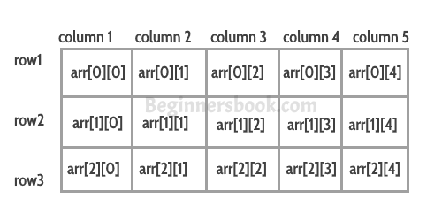
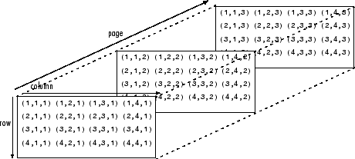
Structure of An Array
Arrays can be single dimensional or multi-dimensional.
Figure on the right shows a two-dimensional and a three-dimensional array.
A multi-dimensional array is just an extension of a 1-D array.
For example ,a 2-D array of dimensions 3*4, can be visualized as a 1-D array of size 3 , with each block pointing to an array of size 4.
Similarly we can extend this analogy to greater dimensions.

Slide 6
Properties of An Array
Each array object has a property named length which can be used to find length of the array.
Whenever we try to access an index in an array which is outside the current range of indices , JVM throws an ArrayIndexOutOfBoundException.
An array of length 0 can be also created. It shall have no containing values. On trying to access any index of such an array, ArrayIndexOutOfBoundException is thrown.
An array once created cannot be changed in size. Values contained in the array can be changed but size of the array itself cannot be changed.
Arrays can be cloned using the clone() method from the object class.

Slide 7
Properties of An Array
As all objects in java extend from Object class , similarly an array object also extends from Object class.
Therefore an array of Object type can hold objects of all types whether it be primitive or reference types.
Since arrays are objects , hence all arrays are assigned default values at the time of creation. All primitive type arrays are assigned default values as zero while non-primitives are assigned null.

Slide 8

Questions ??
a b c

